Slide 1

Connecticut DOT Data Management for Asset Management
William S. Pratt, P.E.
AEC Applications (Architectural, Engineering, Construction)
Karen M. Riemer, P.E.
Transportation Asset Management
Notes:
Acknowledge Bill Pratt – he has been the force behind standardizing our data
AMG works closely with AEC Applications Group (Architectural, Engineering and Construction)

Slide 2
Apr 2015
Nov 2015
Feb 2016
Sep 2016
Dec 2016
TAMP and Data GAP Timelines
TAMP Startup
Bridge & Pavement Workshops
Objectives, Risk and Financial Workshops
DRAFT TAMP
Final TAMP
Data Planning
Identify Gaps
Establish Standards
Layout Plan to Improve
Implement Plan
TAMP
Data
GAP
Notes:
Before we get started → a little background.
Two timelines (TAMP and Data Gap)
Early on realized importance of asset data systems for our TAMP
Data Sharing identified in Gap Analysis

Slide 3
Highway TAMP Assets
Initial TAMP
Future TAMPs
Pavements
Bridges
Sign Supports
Signals
Signs
Pavement Markings
Retaining Walls
Guiderail
Curb Ramps
Lighting & Illumination
Fleet
Buildings
ITS
…
Notes:
Pavement and Bridge as Required
Plan to include others depends on rulemaking → Internal
List of Assets goes on and on … Rumble strips, Outflows and drainage systems, commuter lots

Slide 4
Goals
Keep Asset Inventories Updated
Maximize Data Integration
Notes:
Keep the authoritative database for asset inventory updated with accurate and timely data.
Maximize data integration to remove duplicate data collection and reduce confusion as to which is most recent data.

Slide 5
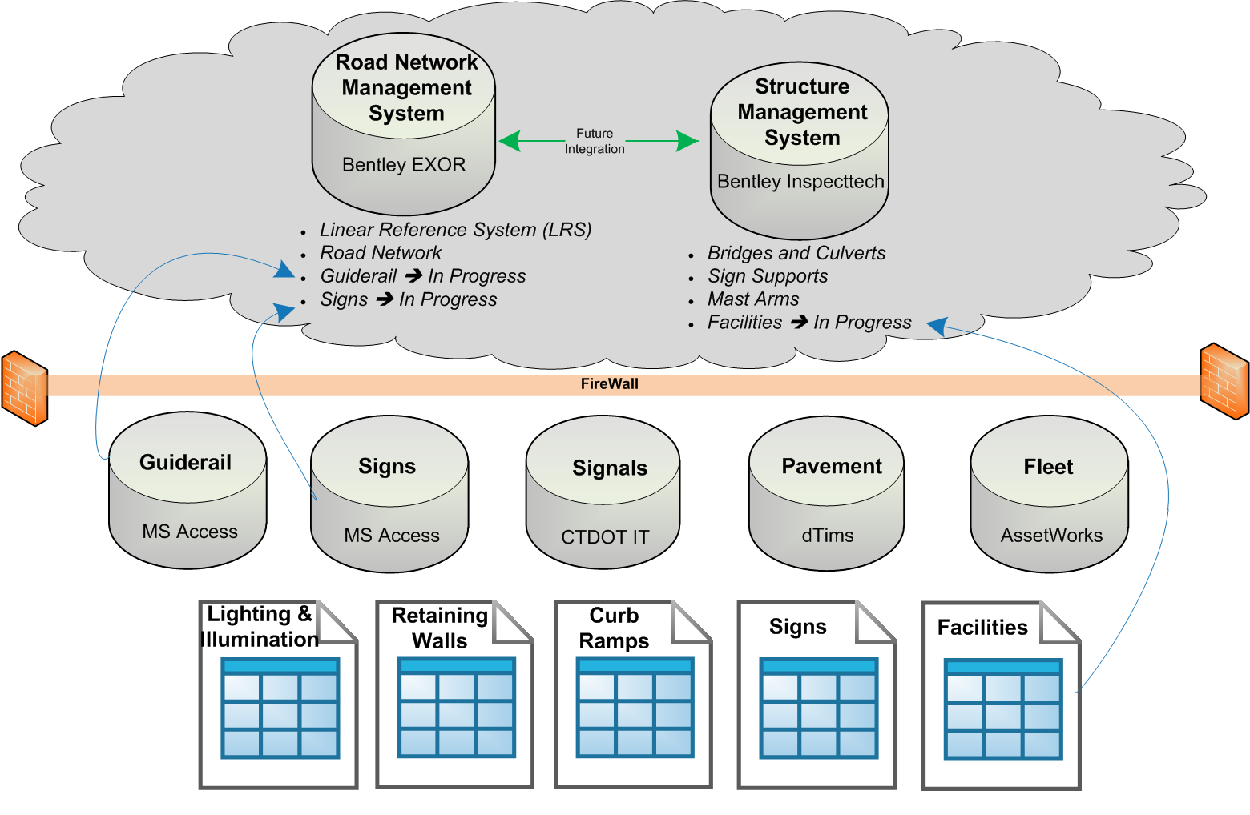
Current Asset Inventory Systems
PCD
TED
Project Composite Data
Transportation Enterprise
Data
Notes:
Basic layout of our inventory systems
Last 2 years → moved to production on two systems in the cloud
Databases and spreadsheets
→ moving towards putting inventories on one of the two platforms (Facilities to Inspecttech / Signs and Guiderail to EXOR will be discussed more in detail)
→ depends if reoccuring assessments and extent of inventory information collected.

Slide 6
Where do the assets get changed during their life?
Construction
Maintenance
Permits
Notes:
- Important step to identify where our assets get touched throughout their life cycle.
- Then broke each down as to how we can capture this work data best.

Slide 7
Identifying Assets in Capital Construction Projects
Project
Timeline
Asset s
Timeline
Update Identification
of Assets @
Final Design Plans
Update Asset Inventory and Conditions @ Construction Complete
Preliminary Identification of Assets @
Project Request
Notes:
Let’s start with Capital Projects.
First these projects can take anywhere from 3 to 10 years to get to construction.
This period of time was taking too long to wait to know what was happening to an asset.
Identified 3 points along the life of a project to capture asset data → Project Request → Final Design → Construction Completion
We are starting with doing this for just a few assets whose authoritative inventory databases are tied to our Project Document Management System ???????.

Slide 8
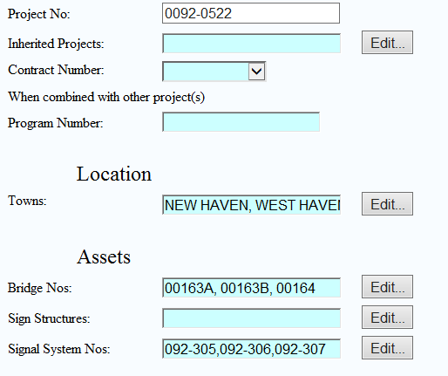
Identifying Assets in Capital Construction Projects
Notes:
Here you can see for a particular project: Bridges, Sign Supports and Signals are identified in the Project Composite Database.
This information is entered at Project Request and updated at Final Design.

Slide 9
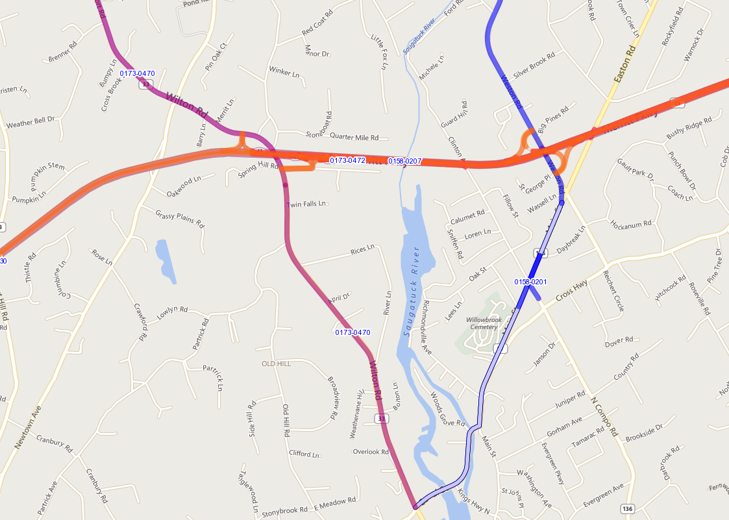
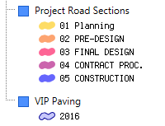
Identifying Assets in Capital Construction Projects
Notes:
Projects are no longer shown as a point on a map but rather as a polygon.
The polygon is stored in the TED (Transportation Enterprise Database). The TED also contains asset data directly from the asset inventories which it links with the project data which resides in a system we call PCD (Project Composite Database). This is where the assets included in a project is listed.
Projects are displayed by color corresponding to the phase that the project is now in. This coloring is based on dates from a variety of resources: finance’s obligation plan, engineering’s project composite database, and construction’s payout system. Although some of the date entries are manual for local projects we are working on a process to remove the manual effort.
This project mapping has been a very critical tool in that prior to this mapping, designers, maintainers and permit developers did not have a single source to know what work was happening around them or in some cases through them. We have experienced some situations where multiple parties were on a work site at the same time through three different avenues.

Slide 10
Harvesting Assets in Capital Construction Projects
CAD Design
CAD Assets to GIS
Asset DB Proposed
Field Verify
Asset DB Confirm

Slide 11
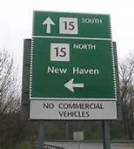
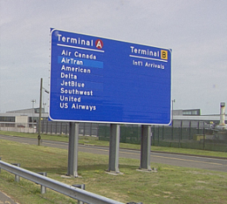
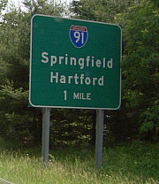
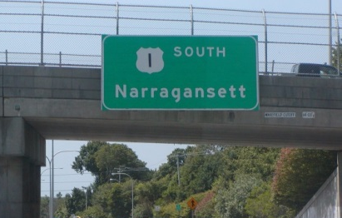

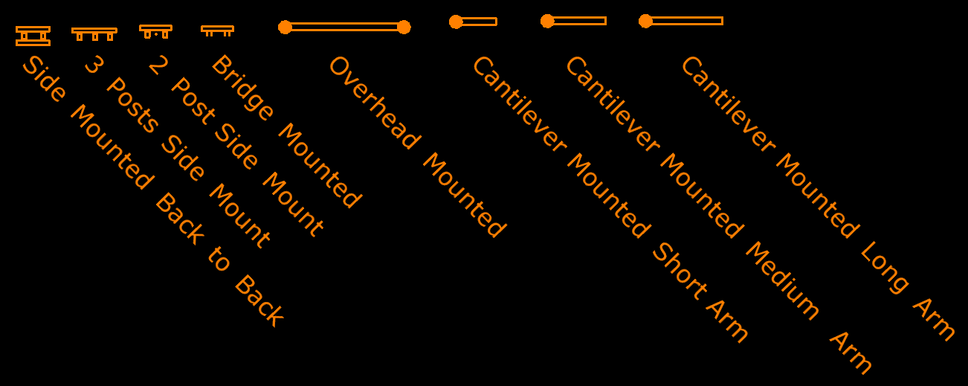
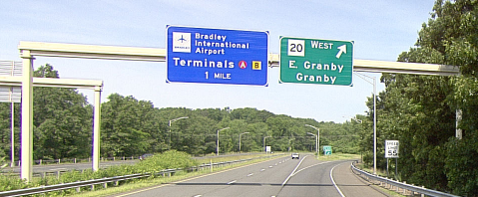
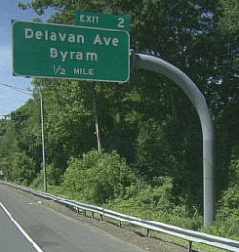
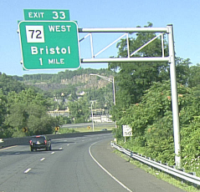
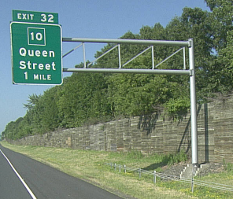
Harvesting Assets in Capital Construction Projects
SF of Sign Face
Extruded Aluminum
SF of Sign Face
+
Structure
+
Foundation

Slide 12
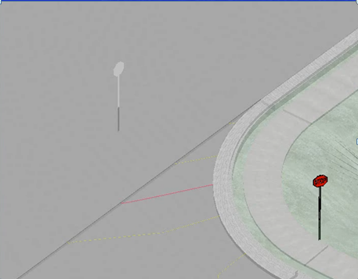
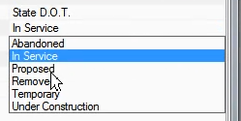
Harvesting Assets in Capital Construction Projects

Slide 13







Identified Who Will Collect and When
SIGNS | GUIDERAIL

Slide 14
Identified What Will Be Collected
Signs
Sign Id
Location
Mounting Type
Sheeting Type
Installation/Removal Date
Manufacturer
Manufacture Date
Images / Photos
Guiderail
Guiderail Segment
Location
Type
End Terminals
Installation/Removal/Repair Date
Installer
Images / Photos
White ➔ Verify CAD Attributes
Orange ➔ Field Capture Input

Slide 15
Challenges CTDOT Faces:
Implementing Business Processes (Users, Technology, QA/QC)
Harvesting Assets at Design
Field Capture of Asset Data at Work Completion
Incorporate Pavement Asset Data
Integrate all Asset, Road Network and Project Management Systems wherever possible to avoid duplication of efforts and out-of-date data.

Slide 16
Progress CTDOT Made:
Developed a Common Linear Reference System (LRS)
Identified Authoritative Asset Databases
Tracking Assets within Projects

